Slide 1
REVIEW-2 ECE4003-EMBEDDED SYSTEM DESIGN
OBSTACLE AVOIDING ROBOT FOR CLEANING

Slide 2
TEAM MEMBERS
1.17BEC1208-D.CHARAN
2.17BEC1142-P.KARTHIK
3.17BEC1195-M.B.V.SRI HARSHA
4.17BEC1124-K.MADHU SEKHAR

Slide 3
OBJECTIVE AND MOTIVATION
Objective:
To build an obstacle avoiding robot using ultrasonic based sensors and can be used for cleanliness of society
Motivation:
Internationally driverless cars & articulated vehicles are state of the art.
Critical technological challenges are being experienced in using AI techniques with microcontrollers and sensors.
This has motivated our Team to develop a technology in India

Slide 4
principle
. The project is designed to build an obstacle avoiding robotic vehicle using ultrasonic sensors for robotic movement and for cleaning the roads and untidy places.
An Arduino development is used to achieve the desired operation.
A robot is a machine that can perform some task automatically or with guidance.
Robotics is generally a combination of computational intelligence and physical machines (motors).
Computational intelligence involves programmed instructions.
The project proposes robotic vehicle that has an intelligence built in it such that it guides itself whenever an obstacle comes ahead of it.
This robotic vehicle is built, using a microcontroller of Atmel family of Arduino Board.
An ultrasonic sensor unit is used to detect any obstacle ahead of it that sends a command to the Arduino Board.
Depending on the input signal received, the microcontroller redirects the robot to move in an alternate direction by appropriately actuating the motors interfaced to it through a motor driver IC.

Slide 5
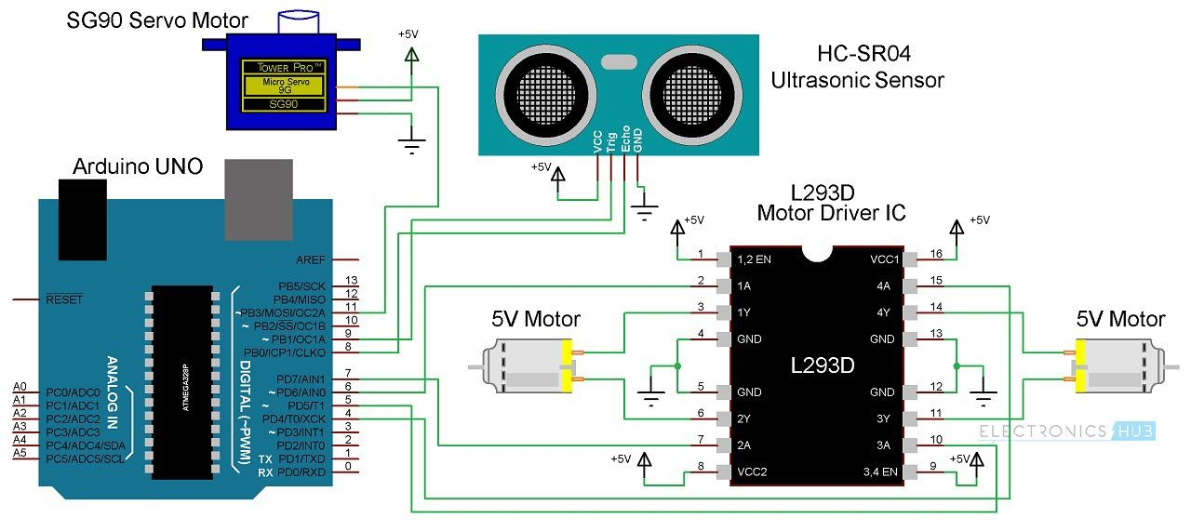
Block/circuit diagram

Slide 6
Components description
Arduino Uno
Arduino Uno is an ATmega 328p Microcontroller based prototyping board. It is an open source electronic prototyping platform that can be used with various sensors and actuators.
Arduino Uno has 14 digital I/O pins out of which 6 pins are used in this project.
HC – SR04
It is an Ultrasonic Range Finder Sensor. It is a non-contact based distance measurement system and can measure distance of 2cm to 4m.
L293D
It is a motor driver which can provide bi-directional drive current for two motors.
Servo Motor
The Tower Pro SG90 is a simple Servo Motor which can rotate 90 degrees in each direction (approximately 180 degrees in total).

Slide 7
Project description
In this project we are going to implement a bot which is going to detect obstacle and according to that ,it changes its direction and cleans the surface
For this we require-
Arduino UNO
Ultrasonic Sensor
LM298N Driver Module
DC Gear Motor
Cleaning Device
Now first we are going to connect ultrasonic sensor with Arduino board. Then according to program our ultrasonic sensor triggers a signal which is received by the echo pin of Ultrasonic sensor.
Then we are going to run an algorithm according to which we manipulate the desired distance for obstacle detection. And then we control motor rotation direction for movement of the bot. And we attach a simple cleaning device at the bottom of the bot and with this we are able to clean the surface of roads and etc

Slide 8
Cost analysis
ARDUINO UNO - 500 Rs/-
HC-SRO4 ULTRASONIC SENSOR MODULE - 150 Rs/-
LM298N DRIVER MODULE - 200 Rs/-
5V DC MOTORS - 150 Rs/-X2=300Rs/-
BATTERY - 40 Rs/-
WHEELS - 400Rs/-
CHASIS - 250Rs/-
CLEANING DEVICE - 50Rs/-
TOTAL - 1900Rs/-(approx)

Slide 9
Thank you

